Slide 1
Object-Oriented Programming
Mohammad Salman
Dean’s Fellow

Slide 2
Operator Overloading
https://www.learncpp.com/cpp-tutorial/introduction-to-operator-overloading/

Slide 3
Idea Behind Operators
Operators are essentially functions that the compiler calls for us.
In this example, the function being called is,
operator+(int, int)
#include<iostream>
int main()
{
int x { 2 };
int y { 3 };
// x + y equivalent to operator+(x, y)
std::cout << x + y << '\n';
return 0;
}

Slide 4
Idea Behind Operators
In this example, doubles are being added.
The compiler calls the relevant overload
operator+(double, double)
#include<iostream>
int main()
{
double x { 2.1 };
double y { 3.8 };
// x + y equivalent to operator+(x, y)
std::cout << x + y << '\n';
return 0;
}
In both these examples, we were working with built-in data types.

Slide 5
The following doesn’t work.
Fraction isn’t a built-in data type; the compiler doesn’t know how to add these two objects together.
class Fraction
{
private:
int m_num;
int m_den;
public:
Fraction(int num, int den)
: m_num{ num }, m_den{ den }
{}
void show() const
{ std::cout << m_num << '/' << m_den << '\n'; }
};
int main()
{
Fraction f1{ 1, 4 }; // f1 = 1/4
Fraction f2{ 2, 4 }; // f2 = 2/4
std::cout << f1 + f2 << '\n'; // 3/4
return 0;
}

Slide 6
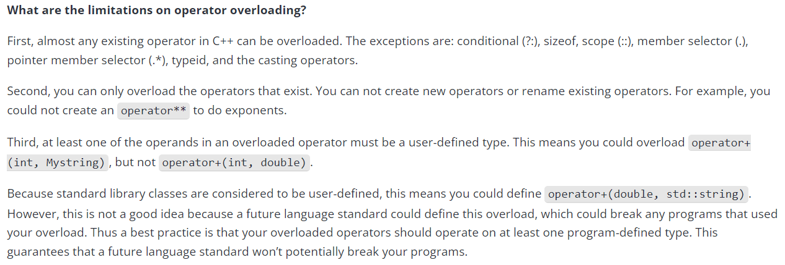
Btw, new and delete are also operators that can be overloaded.
You can even overload the subscript operator (operator[]).
So when we talk about operator overloading, don’t restrict yourselves to just arithmetic operators.

Slide 7
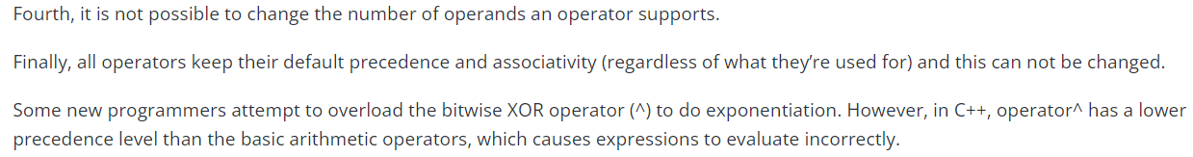
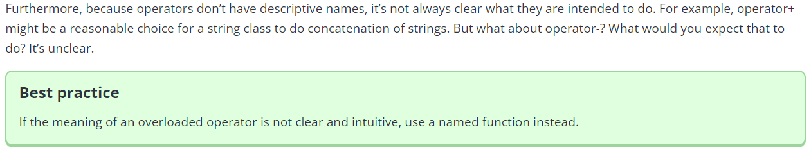

Slide 8
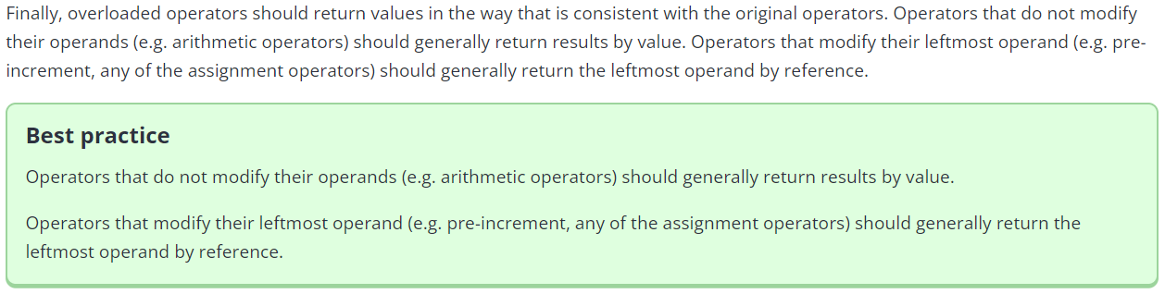

Slide 9
Writing Operator Overloads Using Normal Functions
These functions will not be part of your class.
https://www.learncpp.com/cpp-tutorial/overloading-operators-using-normal-functions/

Slide 10
// This function is NOT part of the class (not a method).
Fraction operator*(const Fraction& frac1, const Fraction& frac2)
{
int resultNum{ frac1.getNum() * frac2.getNum() };
int resultDen{ frac1.getDen() * frac2.getDen() };
Fraction result{ resultNum, resultDen };
return result;
}
Because this function isn’t a member function, I cannot access private members of Fraction-type objects inside this function.
class Fraction
{
private:
int m_num;
int m_den;
public:
Fraction(int num, int den)
: m_num{ num }, m_den{ den }
{}
void show() const
{ std::cout << m_num << '/' << m_den << '\n'; }
int getNum() const { return m_num; }
int getDen() const { return m_den; }
};
int main()
{
Fraction f1{ 1, 4 }; // f1 = 1/4
Fraction f2{ 2, 4 }; // f2 = 2/4
Fraction fracProd{ f1 * f2 };
fracProd.show(); // 2/16
return 0;
}

Slide 11
Note the following.
The name of this function.
The parameters of this function.
The return type of this function.
The implementation logic is based on how fractions get multiplied mathematically.
// Within main() Fraction fracProd{ f1 * f2 };
Fraction operator*(const Fraction& frac1, const Fraction& frac2)
{
int resultNum{ frac1.getNum() * frac2.getNum() };
int resultDen{ frac1.getDen() * frac2.getDen() };
Fraction result{ resultNum, resultDen };
return result;
}

Slide 12
// This function is NOT part of the class (not a method).
Fraction operator*(const Fraction& frac1, int val)
{
int resultNum{ frac1.getNum() * val };
int resultDen{ frac1.getDen() };
Fraction result{ resultNum, resultDen };
return result;
}
Similarly, you can also overload the function in the following way.
class Fraction
{
private:
int m_num;
int m_den;
public:
Fraction(int num, int den)
: m_num{ num }, m_den{ den }
{}
void show() const
{ std::cout << m_num << '/' << m_den << '\n'; }
int getNum() const { return m_num; }
int getDen() const { return m_den; }
};
int main()
{
Fraction f1{ 1, 2 }; // f1 = 1/2
Fraction fracProdInt{ f1 * 3 };
fracProdInt.show();
return 0;
}

Slide 13
Fraction operator*(const Fraction& frac1, int val)
{
int resultNum{ frac1.getNum() * val };
int resultDen{ frac1.getDen() };
Fraction result{ resultNum, resultDen };
return result;
}
Will this also work for the following.
Fraction fracProdInt{ 3 * f1 };
No! Note the order of the parameters in the definition above.

Slide 14
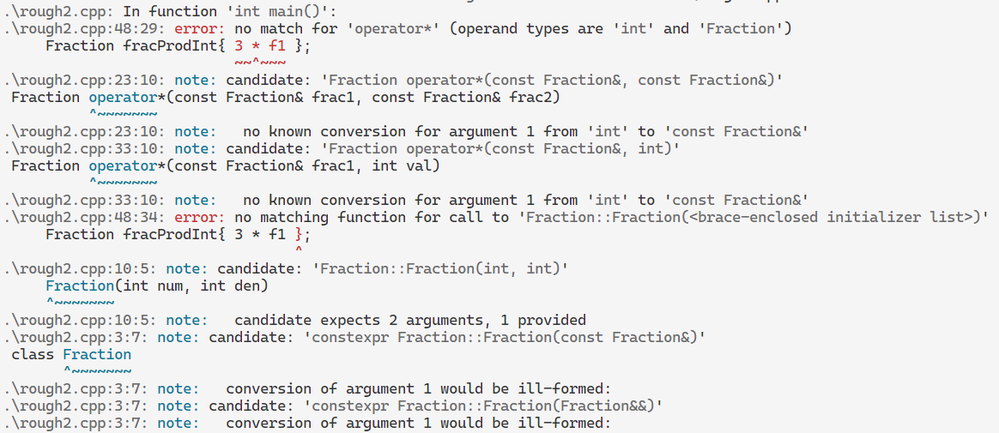
This is the error that comes up.

Slide 15
Do note that,
The first operand becomes the first parameter and,
The second operand becomes the second parameter.
This applies to binary operators (operators that work with two operands).
// Within main() Fraction fracProd{ f1 * f2 };
Fraction operator*(const Fraction& frac1, const Fraction& frac2)
{
int resultNum{ frac1.getNum() * frac2.getNum() };
int resultDen{ frac1.getDen() * frac2.getDen() };
Fraction result{ resultNum, resultDen };
return result;
}

Slide 16
Overloading the I/O Operators
Insertion Operator (<<) and the Extraction Operator (>>)
The following discussion is fully inspired from the reference link provided below.
Please go read.
https://www.learncpp.com/cpp-tutorial/overloading-the-io-operators/

Slide 17
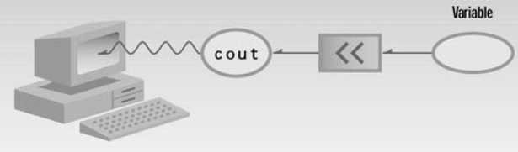
std::cout (contd.)
Figure 2.2 from OOP in C++ by Robert Lafore.

Slide 18

std::cin (contd.)
Figure 2.5 from OOP in C++ by Robert Lafore.

Slide 19
Let’s take a look at a new class for this discussion – class Point.
class Point
{
private:
double m_x;
double m_y;
double m_z;
public:
Point(double x=0.0, double y=0.0, double z=0.0)
: m_x{x}, m_y{y}, m_z{z}
{
}
double getX() const { return m_x; }
double getY() const { return m_y; }
double getZ() const { return m_z; }
};

Slide 20
If you wanted to print the attributes of a Point-type object, you would have to rely on the getters.
This could become tedious.
Point point{5.0, 6.0, 7.0};
std::cout << "Point(" << point.getX() << ", "
<< point.getY() << ", "
<< point.getZ() << ')';
class Point
{
private:
double m_x;
double m_y;
double m_z;
public:
Point(double x=0.0, double y=0.0, double z=0.0)
: m_x{x}, m_y{y}, m_z{z}
{
}
double getX() const { return m_x; }
double getY() const { return m_y; }
double getZ() const { return m_z; }
};

Slide 21
We can make the previous task easier by creating a show() or print() method like we’ve done before.
class Point
{
private:
double m_x{};
double m_y{};
double m_z{};
public:
Point(double x=0.0, double y=0.0, double z=0.0)
: m_x{x}, m_y{y}, m_z{z}
{
}
double getX() const { return m_x; }
double getY() const { return m_y; }
double getZ() const { return m_z; }
void print() const
{
std::cout << "Point(" << m_x << ", " << m_y << ", " << m_z << ')';
}
};

Slide 22
This also has some problems. You will have to do something like this (recall your exam question).
print() returns void, so you cannot cascade this function call with the other print statements.
class Point
{
private:
double m_x{};
double m_y{};
double m_z{};
public:
Point(double x=0.0, double y=0.0, double z=0.0)
: m_x{x}, m_y{y}, m_z{z}
{
}
double getX() const { return m_x; }
double getY() const { return m_y; }
double getZ() const { return m_z; }
void print() const
{
std::cout << "Point(" << m_x << ", " << m_y << ", " << m_z << ')';
}
};
int main()
{
Point point{5.0, 6.0, 7.0};
std::cout << "My point is: ";
point.print();
std::cout << " in Cartesian space.\n";
return 0;
}

Slide 23
It could be a lot better if you could actually do something like this.
int main()
{
Point point{5.0, 6.0, 7.0};
std::cout << "My point is: " << point << " in Cartesian space.\n";
return 0;
}
Currently, we can’t do this, because the compiler doesn’t know how to print Point-type objects.
More precisely, the compiler doesn’t have the function that could print Point-type objects.
OPERATOR OVERLOADING is the answer.
But which operator needs to be overloaded?

Slide 24
We need to overload the insertion operator (<<).
std::cout << point; // dtype of “point” is Point
<< is a binary operator – two operands.
Left operand: an object of type (or class) std::ostream.
Right operand: an object of type (or class) Point
Based on all this information, we have some information about the function that we have to overload.
Name: operator<<
Parameters: (std::ostream& out, const Point& pt) // const b/c I just want to print
Return type: ???
Understanding the return type of this function requires some thinking.

Slide 25
Let’s first see what the implementation of the function looks like to get some ideas.
Basically, I’m just printing the attributes of the Point object.
This will print the attributes on the screen. We could set it to void.
What if we do this in main()?
??? operator<< (std::ostream& out, const Point& point)
{
out << "Point(" << point.getX() << ", " << point.getY() << ", " << point.getZ() << ')';
}
class Point
{
private:
double m_x;
double m_y;
double m_z;
public:
Point(double x=0.0, double y=0.0, double z=0.0)
: m_x{x}, m_y{y}, m_z{z}
{}
double getX() const { return m_x; }
double getY() const { return m_y; }
double getZ() const { return m_z; }
};
int main()
{
Point point1{2.0, 3.0, 4.0};
std::cout << point1;
return 0;
}
Notes:
If you try to return std::ostream by value, you’ll get a compiler error. This happens because std::ostream specifically disallows being copied.

Slide 26
void operator<< (std::ostream& out, const Point& point)
{
out << "Point(" << point.getX() << ", " << point.getY() << ", " << point.getZ() << ')';
}
std::cout << point1 << '\n';
Doesn’t make sense.
Hence, return type cannot be void.
void << '\n';
class Point
{
private:
double m_x;
double m_y;
double m_z;
public:
Point(double x=0.0, double y=0.0, double z=0.0)
: m_x{x}, m_y{y}, m_z{z}
{}
double getX() const { return m_x; }
double getY() const { return m_y; }
double getZ() const { return m_z; }
};
int main()
{
Point point1{2.0, 3.0, 4.0};
std::cout << point1 << '\n';
return 0;
}

Slide 27
std::ostream& operator<< (std::ostream& out, const Point& point)
{
out << "Point(" << point.getX() << ", " << point.getY() << ", " << point.getZ() << ')';
return out;
}
std::cout << point1 << '\n';
What we need to be returned is cout itself.
And so we can return by reference.
std::cout << '\n';
class Point
{
private:
double m_x;
double m_y;
double m_z;
public:
Point(double x=0.0, double y=0.0, double z=0.0)
: m_x{x}, m_y{y}, m_z{z}
{}
double getX() const { return m_x; }
double getY() const { return m_y; }
double getZ() const { return m_z; }
};
int main()
{
Point point1{2.0, 3.0, 4.0};
std::cout << point1 << '\n';
return 0;
}

Slide 28
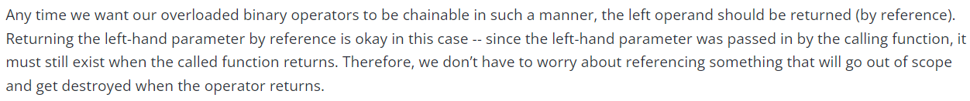
std::ostream& operator<< (std::ostream& out, const Point& point)
{
out << "Point(" << point.getX() << ", " << point.getY() << ", " << point.getZ() << ')';
return out;
}
class Point
{
private:
double m_x;
double m_y;
double m_z;
public:
Point(double x=0.0, double y=0.0, double z=0.0)
: m_x{x}, m_y{y}, m_z{z}
{}
double getX() const { return m_x; }
double getY() const { return m_y; }
double getZ() const { return m_z; }
};
int main()
{
Point point1{2.0, 3.0, 4.0};
std::cout << point1 << '\n';
return 0;
}

Slide 29
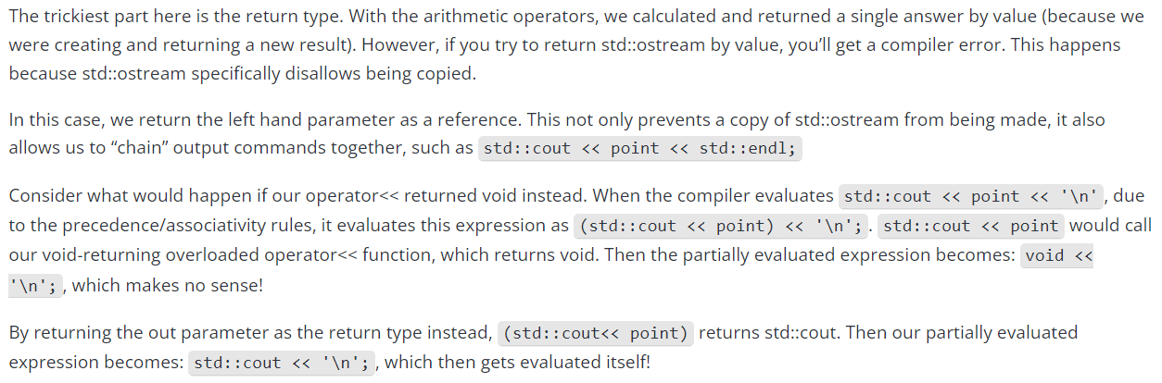
This is the explanation of what we talked about in class.

Slide 30
Implementation of the extraction operator (>>) works in a similar way.
std::cin >> point; // dtype of “point” is Point
>> is a binary operator – two operands.
Left operand: an object of type (or class) std::istream.
Right operand: an object of type (or class) Point
Based on this, this is what our function would look like.
Note that parameter point must be non-const so we can modify the class members with the input values.
std::istream& operator>> (std::istream& in, Point& point)
{
in >> point.m_x;
in >> point.m_y;
in >> point.m_z;
return in;
}

Slide 31
Another thing to note is that the members are private yet I’m accessing them outside the class.
The reason this works is that I can make this function a friend of my class.
class Point
{
private:
double m_x{};
double m_y{};
double m_z{};
public:
Point(double x=0.0, double y=0.0, double z=0.0)
: m_x{x}, m_y{y}, m_z{z}
{}
friend std::istream& operator>> (std::istream& in, Point& point);
};
Similarly, you can also make operator<< a friend of your class as well and then it could also access the private members.
std::istream& operator>> (std::istream& in, Point& point)
{
in >> point.m_x;
in >> point.m_y;
in >> point.m_z;
return in;
}

